Slide 1
"My Recipe Tracker"
By Htet Myet

Slide 2

Track Recipes Efficiently & Organized!

Slide 3


Loves Experiments!
Struggles to Keep Track!

Slide 4
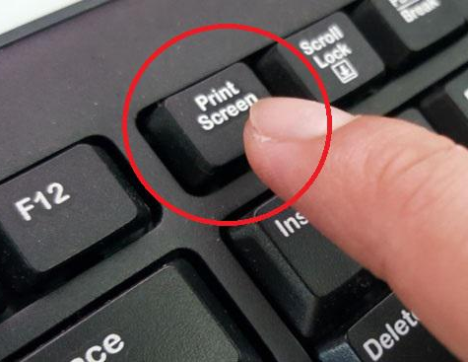

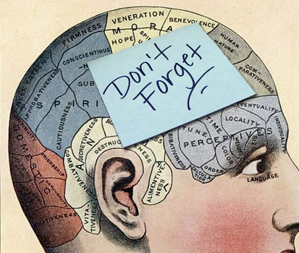
The Struggles!
Writing down notes
Saving Screenshots
Relying on Memory

Slide 5




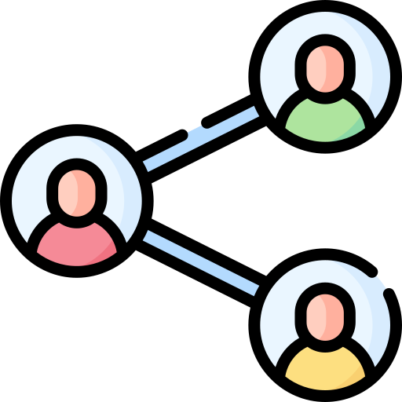
Peter wants an App that allows...
Cooking History Track
Input & Modify
Save & Organize
Filter with Preference
Share

Slide 6

DIGITAL RECIPE BOOK!

Slide 7


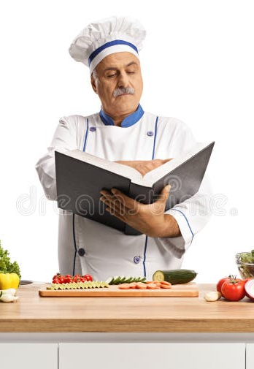
Target Audience
Individuals with Dietary Needs
Home Cooks
Meal Preppers

Slide 8

Keep it Organized and Accessible

Slide 9
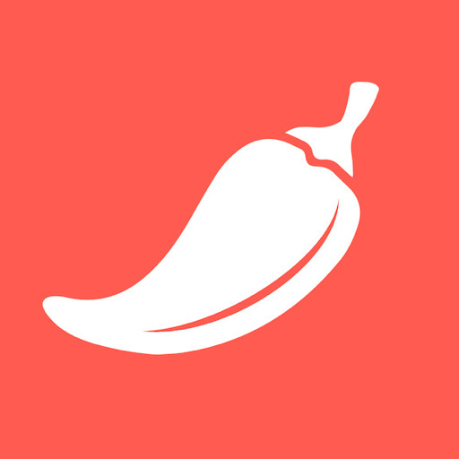

Competitor Analysis
Pepper
Cookpad

Slide 10
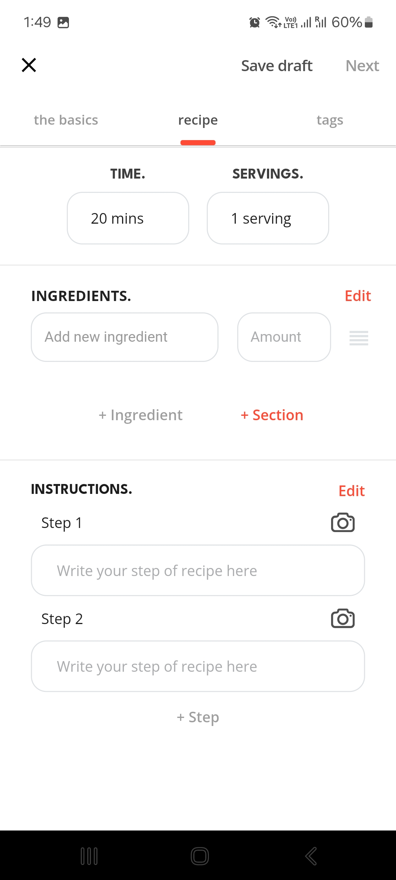
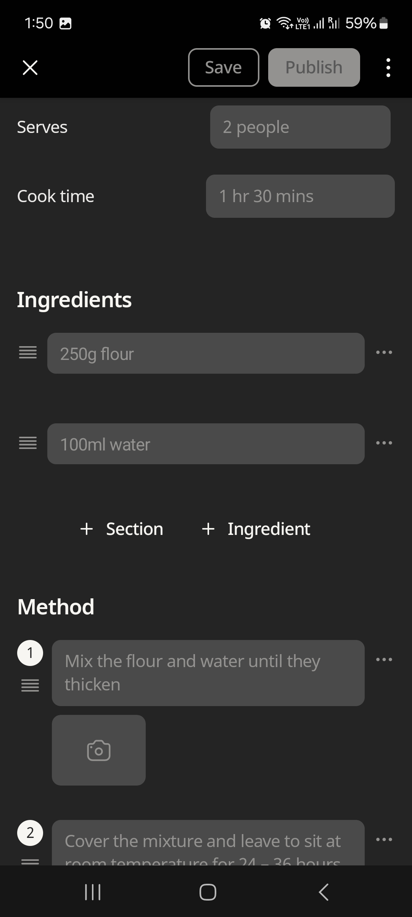
Recipe Input & Modification
Pepper
Cookpad

Slide 11

Recipe Input & Modification (My App)
Pepper
Cookpad

Slide 12

Cooking History Tracking
Pepper
Cookpad
We don't have that!

Slide 13


Cooking History Tracking (My App)

Slide 14
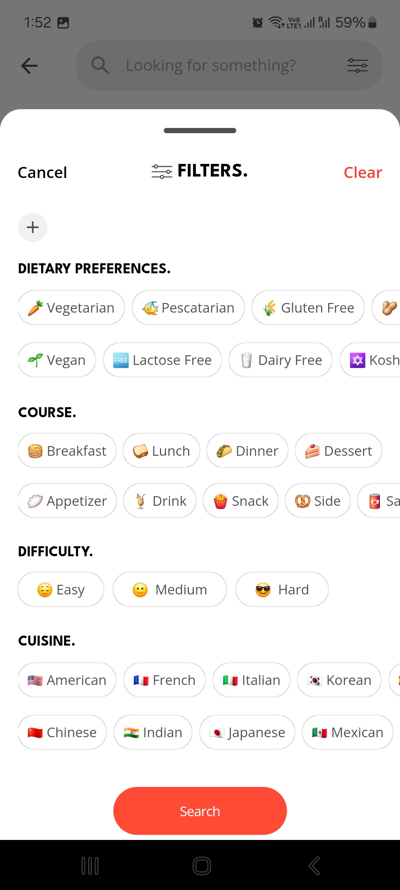
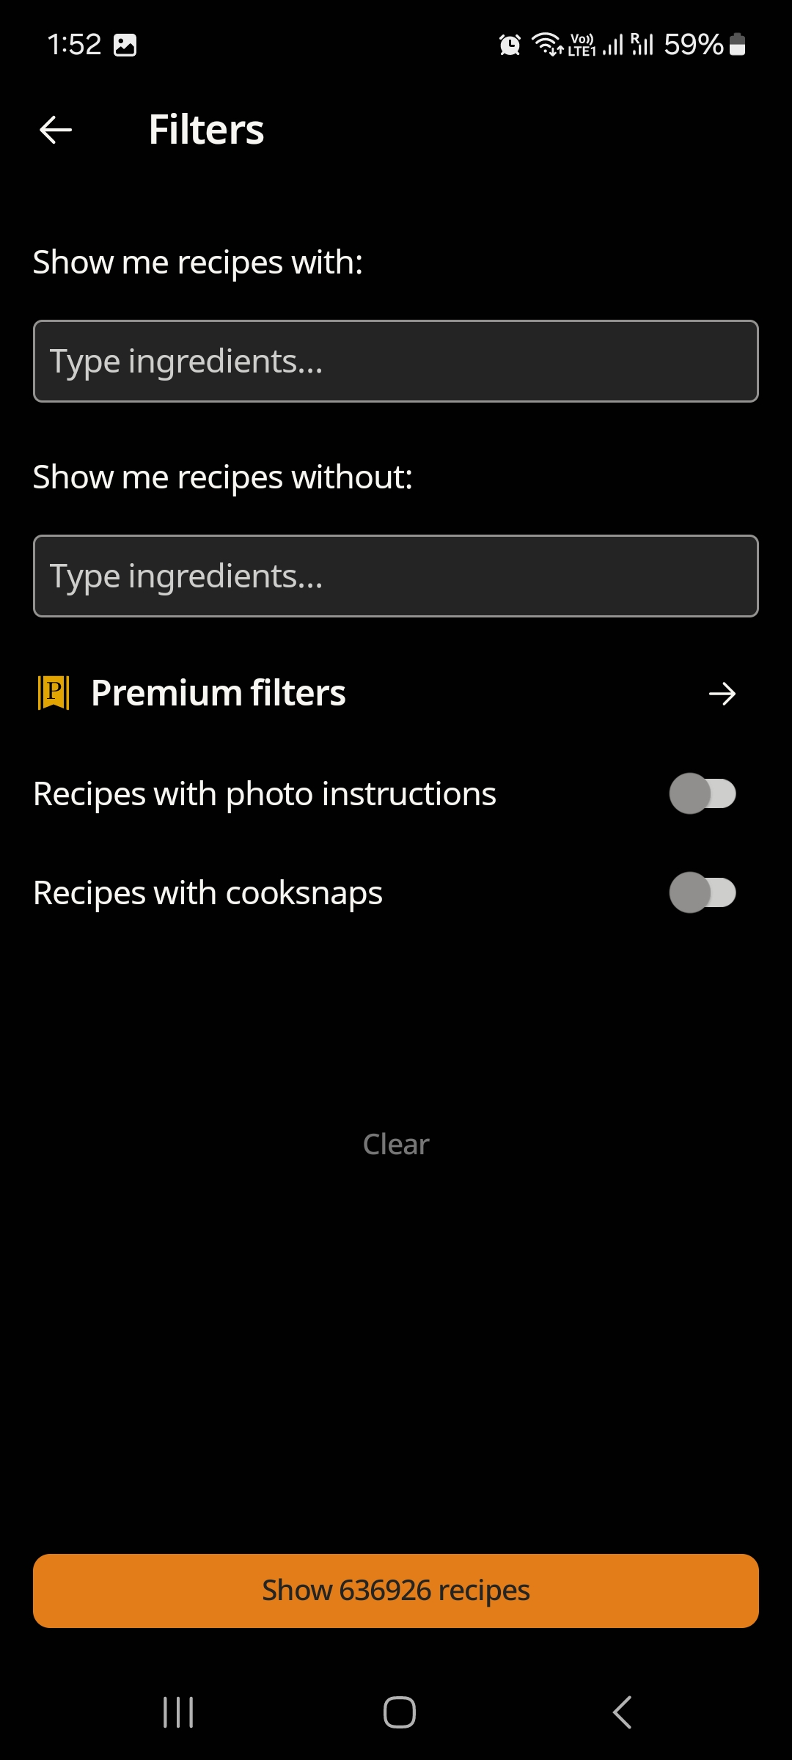
Recipe Filtering
Use Tags
Type with/without
Pepper
Cookpad

Slide 15
Recipe Filtering (My App)
Use Tags
Pepper

Slide 16
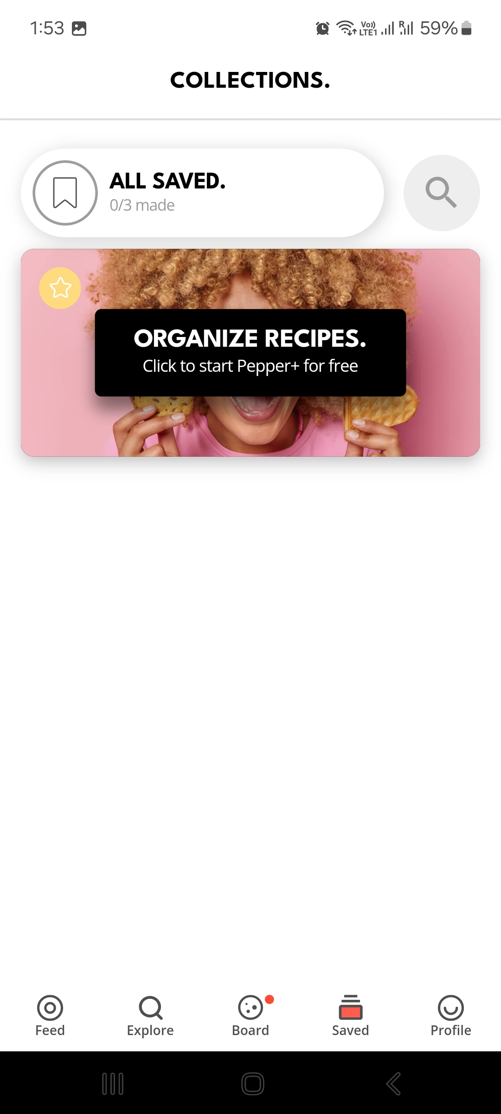
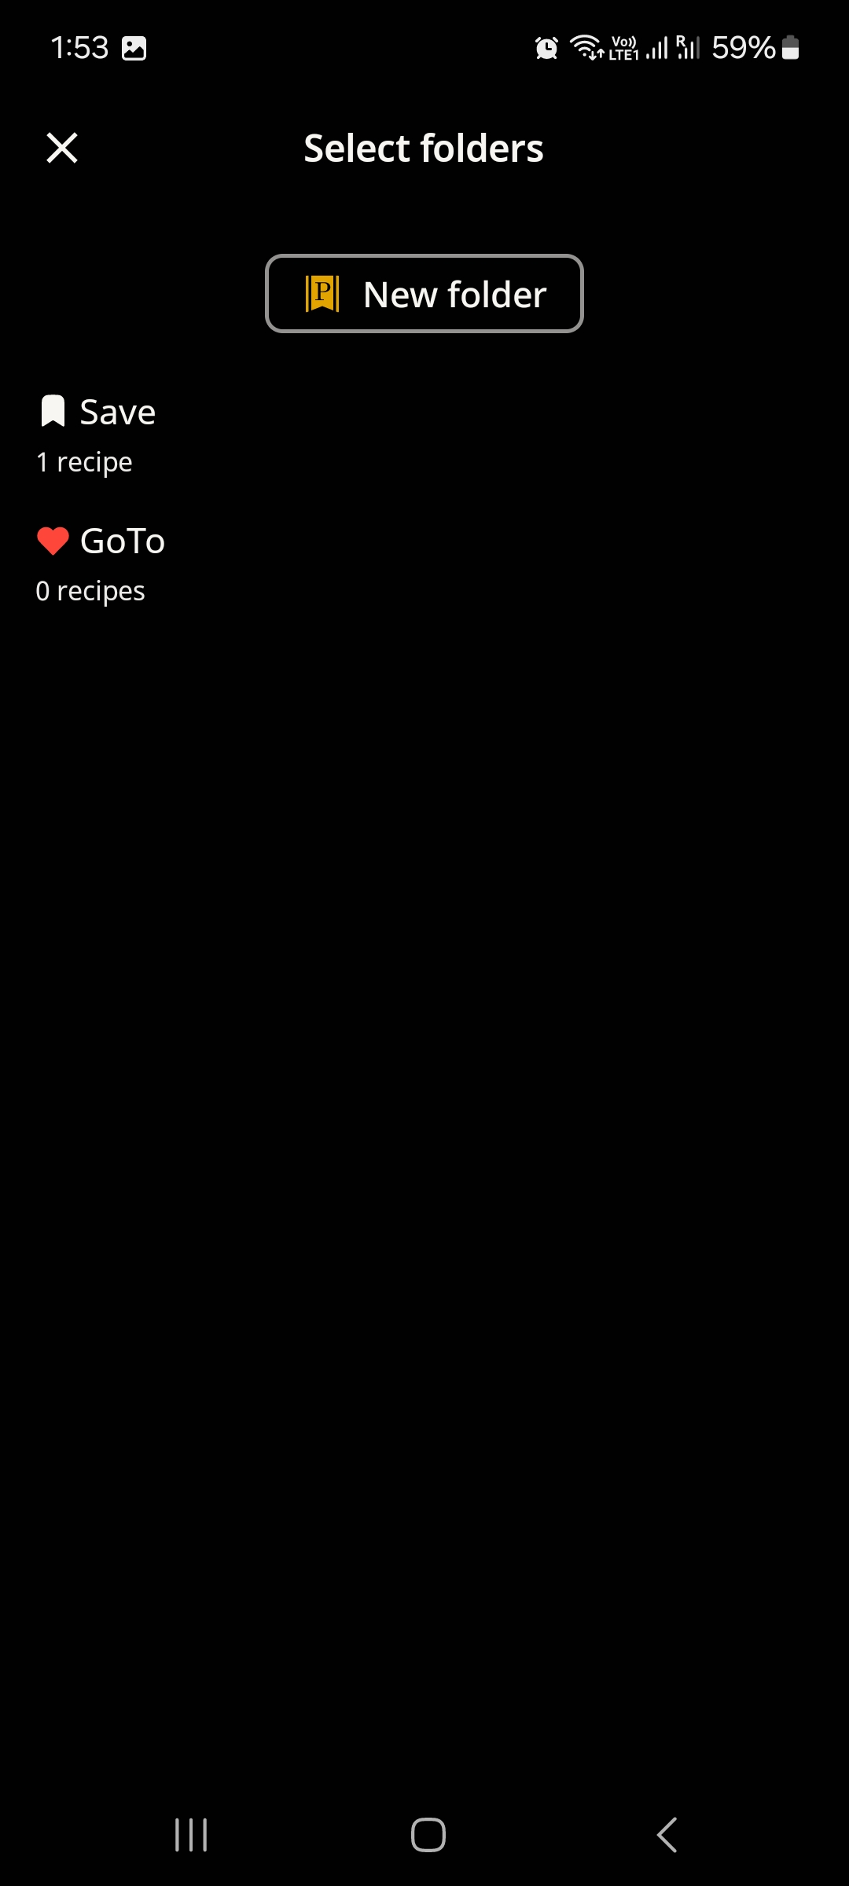
Saving & Organizing Recipes
Default + User Created folders
Just "Save"
Pepper
Cookpad

Slide 17



Saving & Organizing Recipes (My App)
"All Recipes"
"Favorites"
"Drafts"

Slide 18
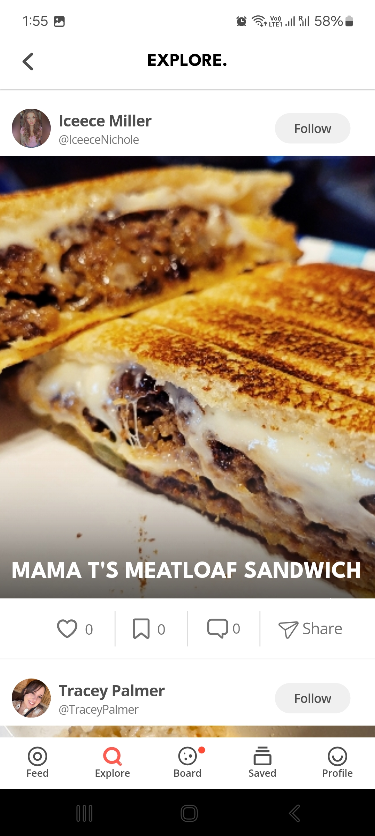
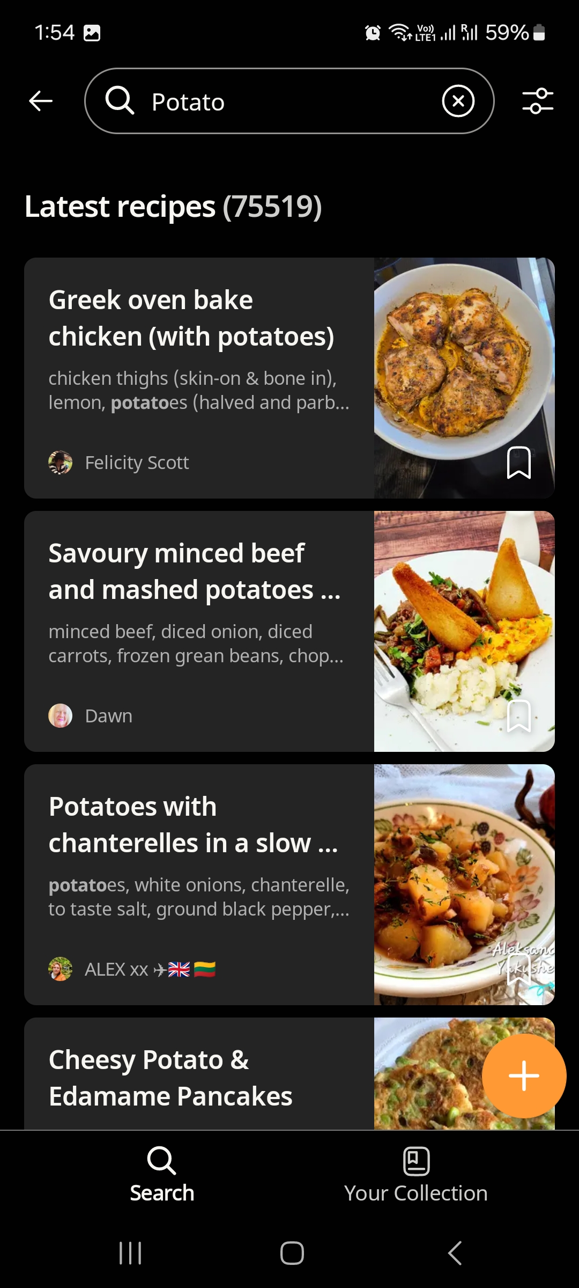
Sharing Recipes
"Instagram" like
Online Recipe Site
Pepper
Cookpad

Slide 19

Sharing Recipes
Export as

Slide 20

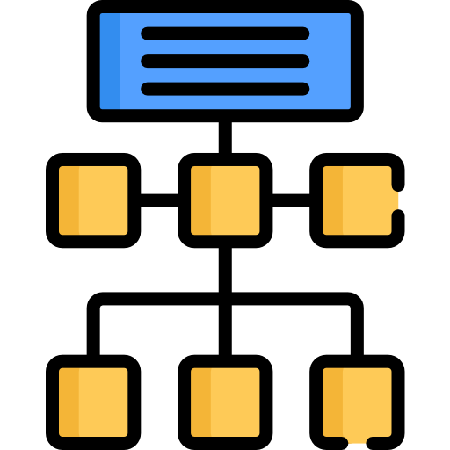

My Recipe Tracker
Simpler
Structured
User-friendly

Slide 21
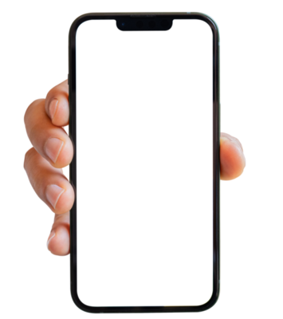
Proposed Features
Input & Modify Recipes
Tag based Filtering for Dietary Needs
Cooking History Tracking
Saving & Organizing
Recipe Sharing as PDFs

Slide 22
"My Recipe Tracker" App Showcase
Made with Figma

Slide 23
Dev Timeline
Week 1 | Finalize wireframes and UI/UX design in Android Studio
Week 2 | Develop core features: Recipe Input, Editing and history tracking
Week 3 | Implement Filtering, Saving, and PDF exporting
Week 4 | Test the app with users and gain feedback
Week 5 | Final fixes and touches and delivery
Project Management:
Agile Methodology

Slide 24

GitHub Repo & VC
Repo Include:
Code & Doc
Wireframes & UI Designs
Notes & Change Logs

Slide 25
Conclusion "My Recipe App"
By Htet Myet

